Slide 1

Digital Signatures

Slide 2
Intuitive Model I
Algorithms
Key generation
Outputs public key k, private key k’
Signature algorithm Sig
Input: message m, private key k’
Output: ciphertext Sig_{k’}(m)

Slide 3
Intuitive Model II
Verification algorithm Ver
Input: message m, signature s, public key k
Output: verification accept/reject
Correctness (standard)
For any valid pair (k, k’) and message m
Ver_{k}(m,Sig_{k}(m))=accept

Slide 4
Intuitive Model III
Many legitimate receivers
Alice, k
One sender
(M_{A},Sig_{k’}(M_{A}))
Bob, k’
(M_{B},Sig_{k’}(M_{B}))
Carol, k
(M_{C},Sig_{k’}(M_{C}))
Dorothy, k

Slide 5
Security I
Scheme is secure
If adversary cannot generate (m,s) s.t.
Ver_{k}(m,s)=accept
Adversary hasn’t received (m,s)
Several variants depending on
Adversary access
Forgery type

Slide 6
Security II
Adversary Access
Key only – adversary has k
Known message
Adversary receives (m_{i},Sig_{k’}(m_{i})), for i=1,…,n
Chosen message
Adversary chooses(m_{i},Sig_{k’}(m_{i})), for i=1,…,n

Slide 7
Security III
Forgery type
Universal forgery
Adversary can forge (m,s) for any message m
Selective forgery
Adversary can forge (m,s) for message m chosen before attack begins
Existential forgery
Adversary can forge (m,s) for some message m

Slide 8
Security IV
Signature scheme is called secure
If it is secure against existential forgery

Slide 9
Applications of Signatures
Legally binding signatures
Contracts, official documents etc.
Payments
In theory replaces trusted parties, e.g. credit-card companies
User authentication (identification)
Code signing

Slide 10
Code Signing I
Setting
Platform running code
Platform receives new code
Platform wishes to verify that code is valid
Examples
Secure boot for hardware device
Application SW / drivers running on Operating System
Software update

Slide 11
Code Signing II
Software creator
Private key k’
Kept secret!
Generated SW
Platform
(SW, Sig_{k’}(SW))
Other SW
Public key k
Verification program
Tamper-proof
Not secret
If Ver_{k}(SW, Sig_{k’}(SW))=accept
Load SW
Else – raise error

Slide 12
RSA Signatures – Attempt
Key generation
RSA keys: public (n, e), private d
Signature on message m
m^{d} mod n
Verification of (m, s)
Accept if s^{e}≡m mod n
Intuition – key only, selective security for randomly selected message m is equivalent to breaking RSA

Slide 13
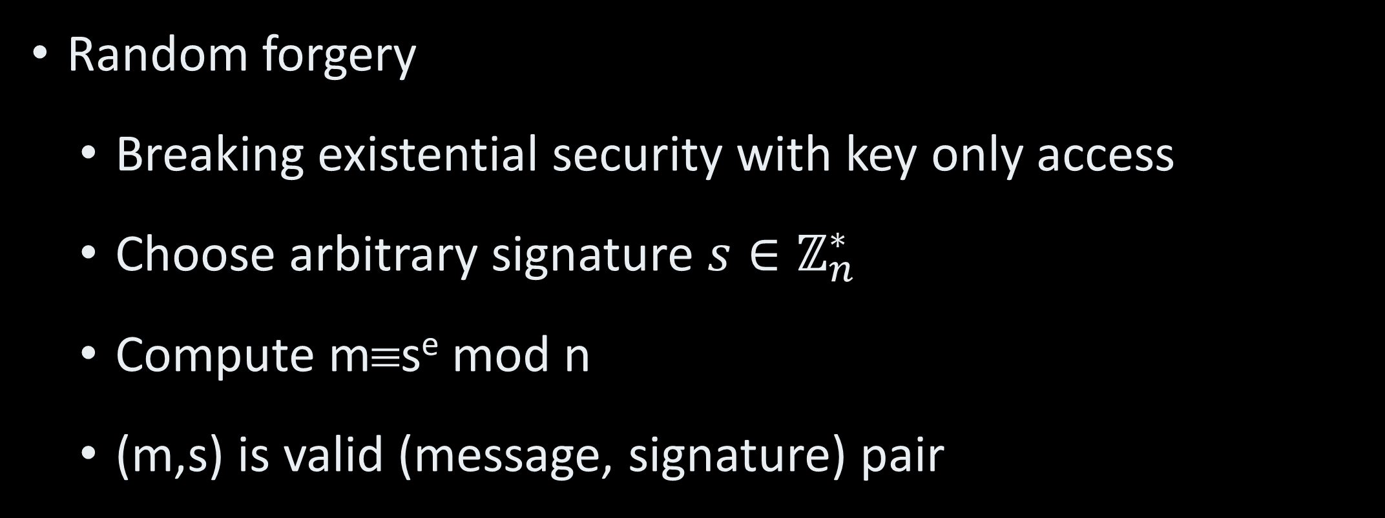
Attacks I
Random forgery
Breaking existential security with key only access
Choose arbitrary signature $s∈ℤ_{n}^{∗}$
Compute m≡s^{e} mod n
(m,s) is valid (message, signature) pair

Slide 14
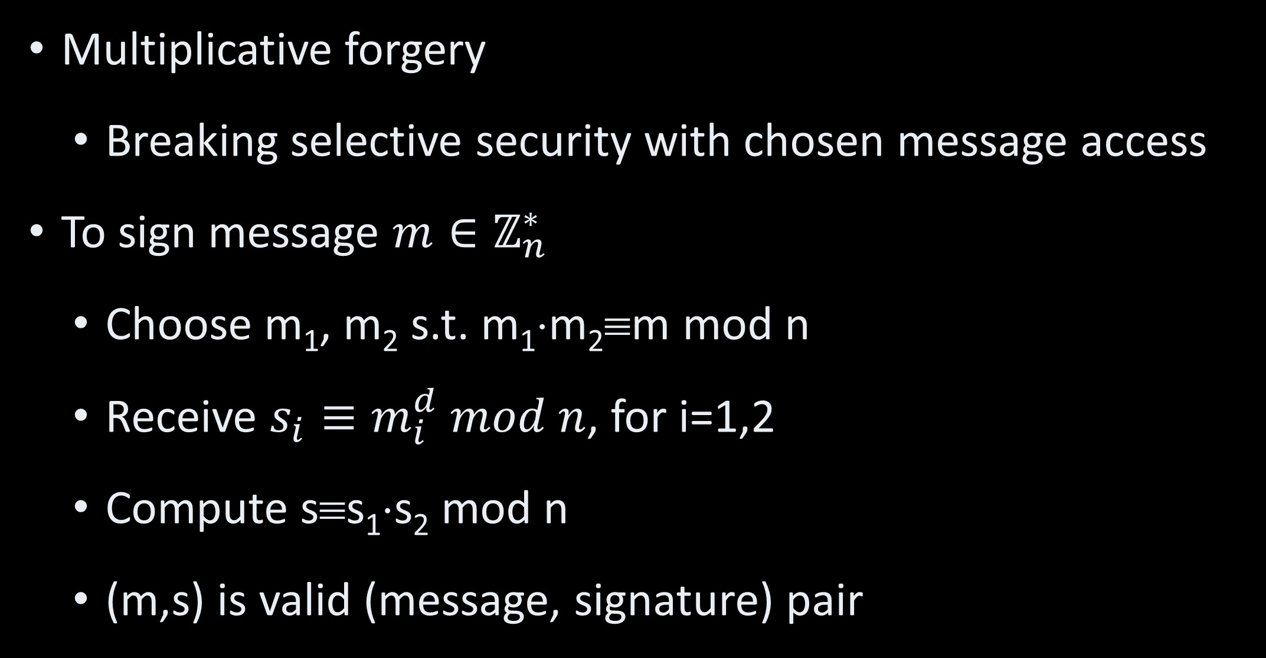
Attacks II
Multiplicative forgery
Breaking selective security with chosen message access
To sign message $m∈ℤ_{n}^{∗}$
Choose m₁, m₂ s.t. m₁⋅m₂≡m mod n
Receive $s_{i}≡m_{i}^{d} mod n$, for i=1,2
Compute s≡s₁⋅s₂ mod n
(m,s) is valid (message, signature) pair

Slide 15
RSA Signatures
Key generation
RSA keys: public (n, e), private d
Signature on message m
h(m)^{d} mod n for cryptographic hash function h
Verification of (m, s)
Accept if s^{e}≡h(m) mod n
Theorem: If the RSA assumption is correct then RSA signatures are secure in the Random Oracle Model

Slide 16
Signature Algorithms
RSA
Standard – PKCS#1
DSS (Digital Signature Standard)
Based on ElGamal signatures
ECDSA – Elliptic Curve analog of DSS
Post quantum NIST standardization effort
In parallel to post-quantum PKE and Key Exchange effort

